Slide 1
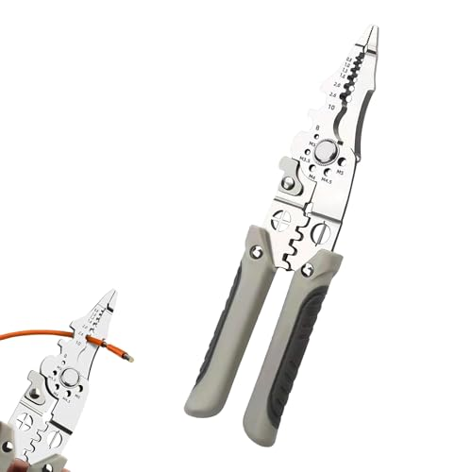
Introducing the YTH Z601 Multifunctional Tool A high-performance, all-in-one professional hand tool engineered for versatility, efficiency, and durability — designed to streamline multiple tasks with a single device. Key Benefits: ✔ True All-in-One Functionality ✔ Professional-Grade Performance ✔ Efficiency & Time Savings ✔ Cost-Effective Solution

Slide 2
Why Choose YTH Z601? • Reduces workload and tool clutter • Delivers higher efficiency and precision • Offers professional results without complexity • A smart investment for serious workers and hobbyists alike

